Slide 1
T-TER: Defeating A2 Trojans with Targeted Tamper-Evident Routing
Timothy Trippel, Kang G. Shin
Computer Science & Engineering
University of Michigan
Kevin B. Bush
Cyber Physical Systems
MIT Lincoln Laboratory
Matthew Hicks
Computer Science
Virginia Tech

Slide 2
Outline
Abstract
Introduction
Guard Wire Bypass Attacks
Tamper-Evident Guard Wires
Implementation
Evaluation

Slide 3
Outline
Abstract
Introduction
Guard Wire Bypass Attacks
Tamper-Evident Guard Wires
Implementation
Evaluation

Slide 4
Abstract
T-TER is directed and routing-centric, which T-TER guard wires must be tamper-evident in both the digital (deletion attacks) and analog (move and jog attacks) domains
T-TER defeats even the stealthiest known hardware Trojan, with ≈ 1% overhead

Slide 5
Outline
Abstract
Introduction
Guard Wire Bypass Attacks
Tamper-Evident Guard Wires
Implementation
Evaluation

Slide 6
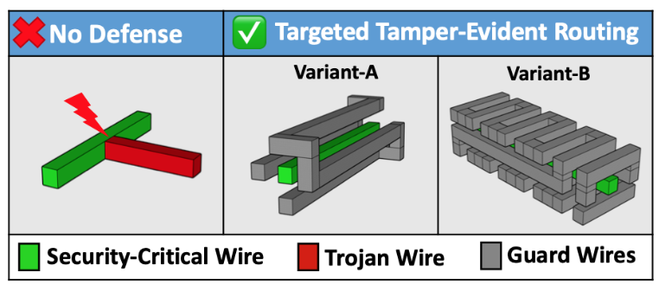
Introduction

Slide 7
Introduction
The A2 Trojan only requires only two additional cells, so reduce the exploitable region is hard to defend the trojan attack
T-TER has 2 targets:
Completely shielding all surfaces if critical wires
The shielding wires must be tamper-evident
T-TER mainly focuses on preventing Victim/Trojan Integration

Slide 8
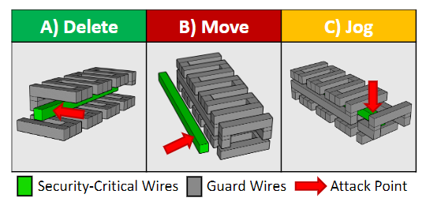
Guard Wire Bypass Attacks

Slide 9
Tamper-Evident Guard Wires
Naïve Approach: Re-purpose Existing Wires
Use the existing non-security-critical net to as guard wires
This approach create hyper-local routing density near security-critical nets
This way will not incur hardware overhead but hard to implement
Designed-in Guard Wires
This guard wire do not implement any functionality, and will incur hardware overhead

Slide 10
Tamper-Evident Guard Wires
There are many ways can detect the tampering of the guard wires:
On-chip:
Internal sensor
Ring oscillator

Slide 11
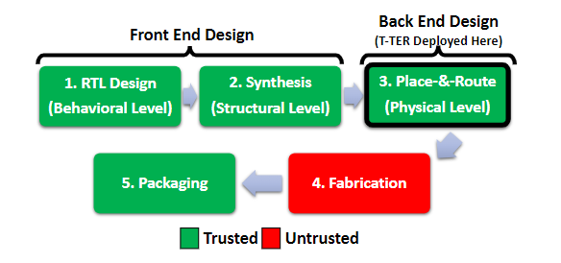
Implementation

Slide 12
Implementation
PaR steps:
Floorplaning
Their toolchain
Place identified components and route identified wires and their guard wires
The toolchain will permanently fixed these components and wires (e.g. set as don’t touch)
Placement
CTS
routing
filling

Slide 13
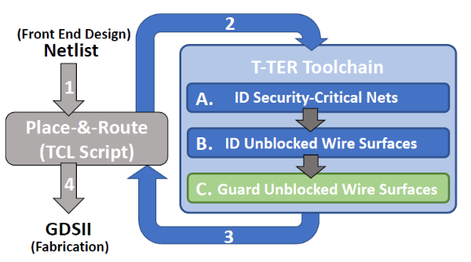
Implementation – Automated Tool
Contain 3 phases:
Identify security-critical nets
Identify the unblocked surfaces of all of these nets within a GDSII-encoded layout
Guard the nets and their influencer nets by routing guard wires nearby

Slide 14
1. Identify security-critical nets
They assume that the security-critical nets (root net) are with prefix : secure_
The toolchain will later locate the direct fan-in of each root net (with configurable depth)
It will also disable the optimization of all root nets
Rather than target the root net, an adversary is more likely to elect to target the influencer of the root net (BFS)

Slide 15
2. Identifying Unblocked Wire Surfaces
Use the method of 3-D scanning window approach
If the there exists an region that meets the minimum spacing requirement, the region will be seen as unblocked
The output of this approach is a list of coordinates that must be filled with guard wires

Slide 16
3. Guard Unblocked Wire Surfaces
Use Innovus to implement to guard wires

Slide 17
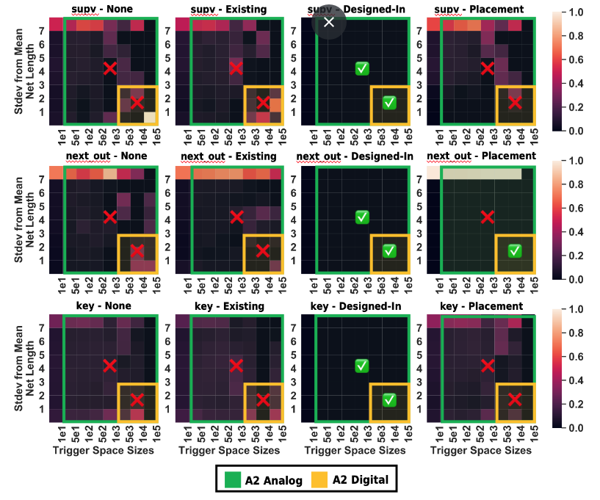
Evaluation

Slide 18
